Slide 1
Statistical Methodology for
Software Engineering
Hadas Lapid, PhD
Statistics for Software
Engineers
Notes:
An Introduction to Statistical Methods and Data Analysis 7th Edition
R. Lyman Ott Michael Longnecker
Chap. 6, page 300

Slide 2
Contents
Comparison of two unpaired sample means using t-test
Statistics for Software
Engineers

Slide 3
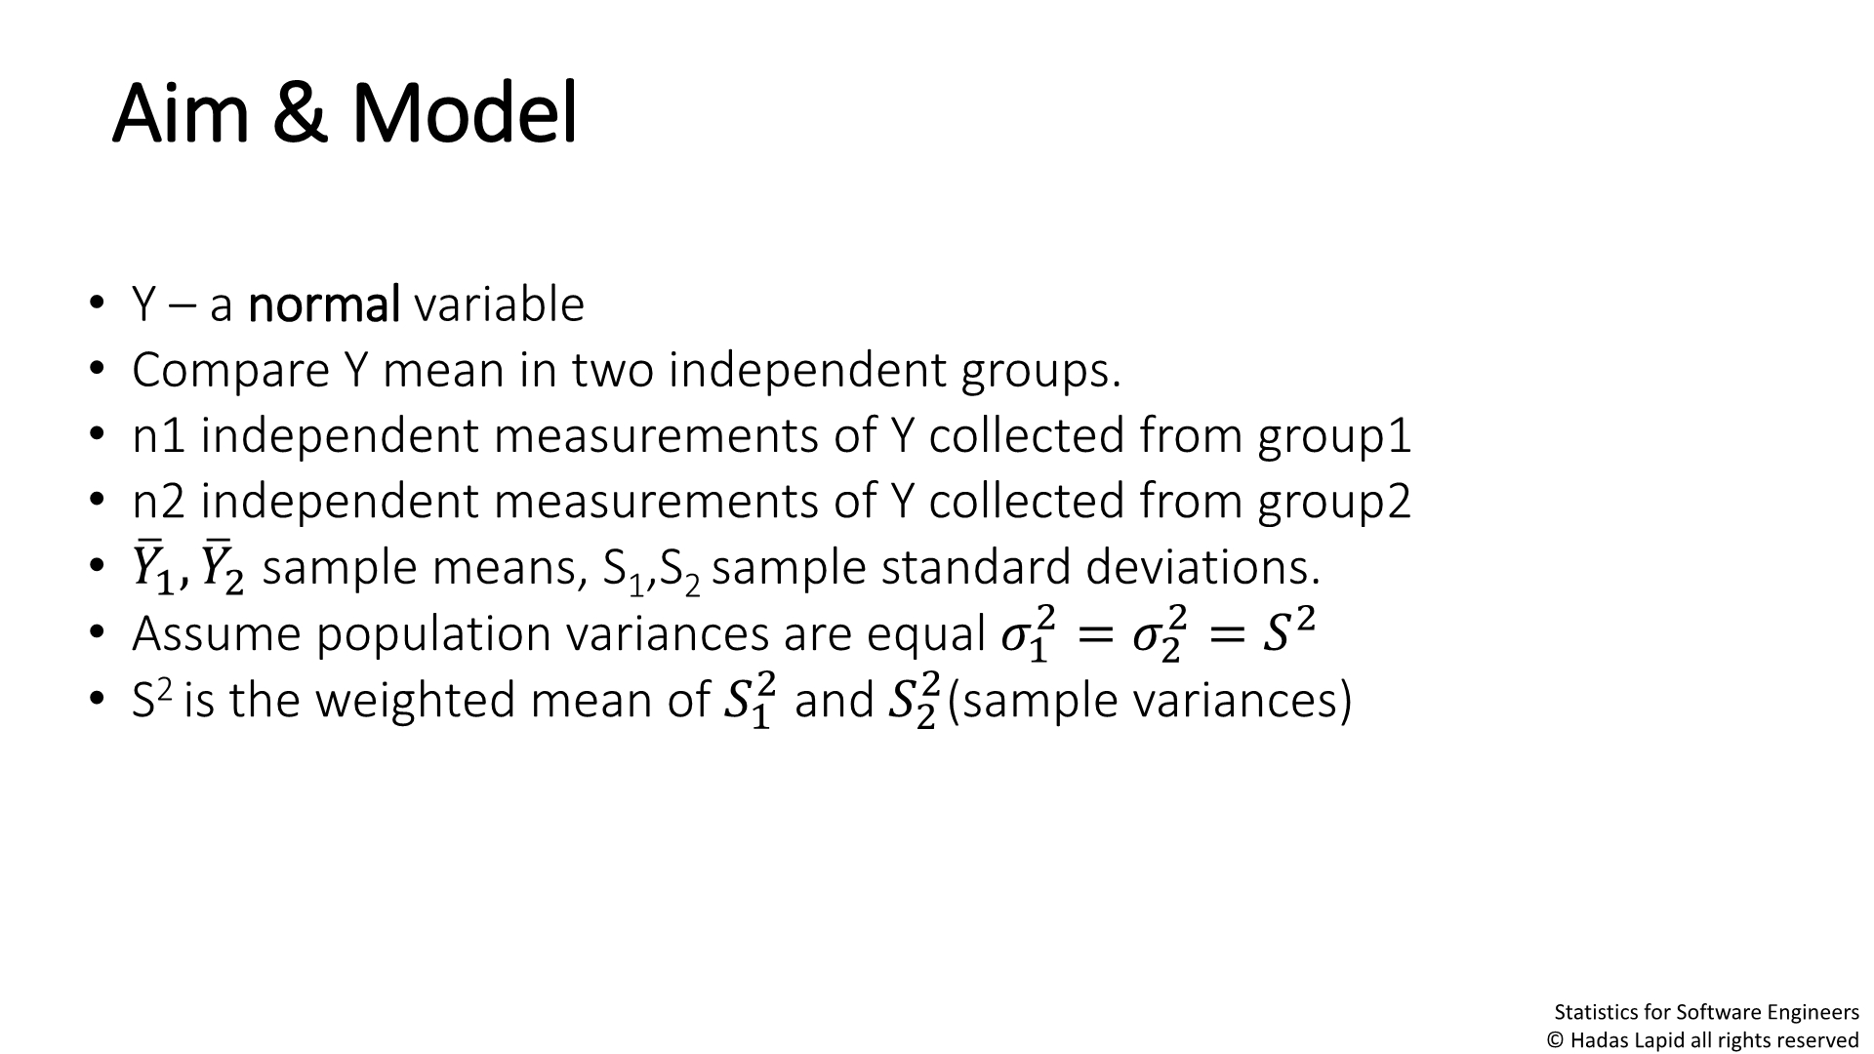
Aim & Model
• Y – a normal variable
• Compare Y mean in two independent groups.
• n1 independent measurements of Y collected from group1
• n2 independent measurements of Y collected from group2
• ത^{ത} ,
ത
ത sample means, S ,S sample standard deviations.
1
2
1 2
ത = ത = ത
• Assume population variances are equal
2
2
2
ത and ത (sample variances)
1
2
• S² is the weighted mean of
2
2
1
2
Statistics for Software
Engineers

Slide 4
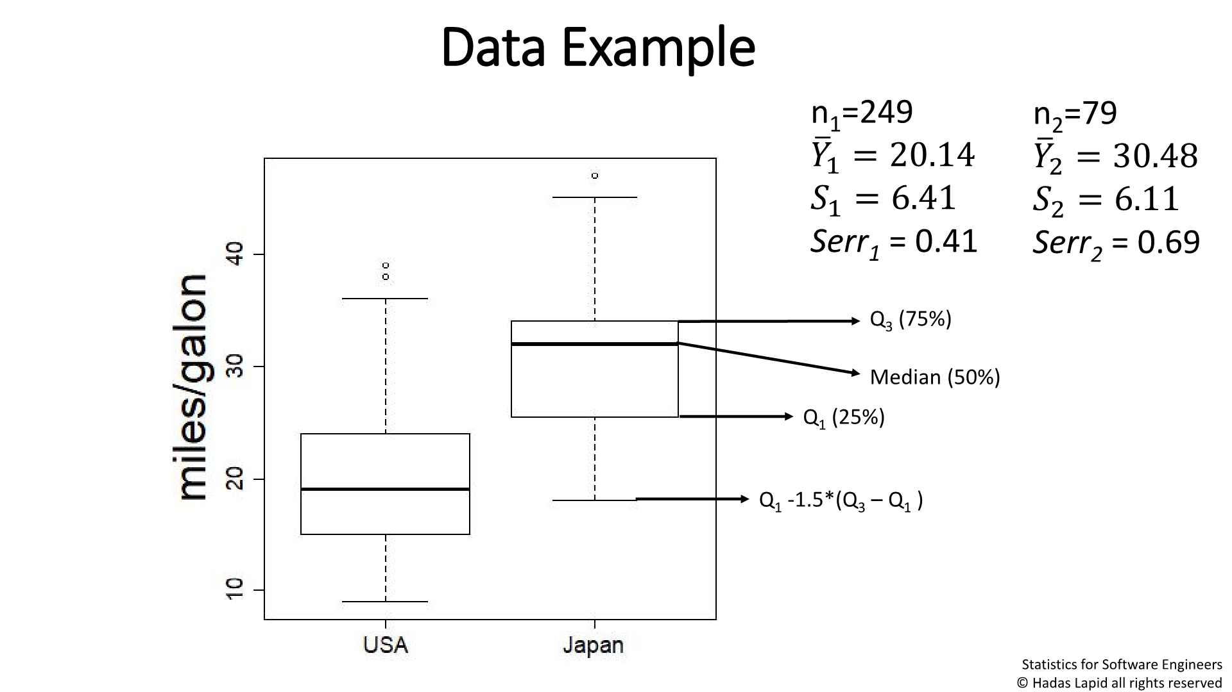
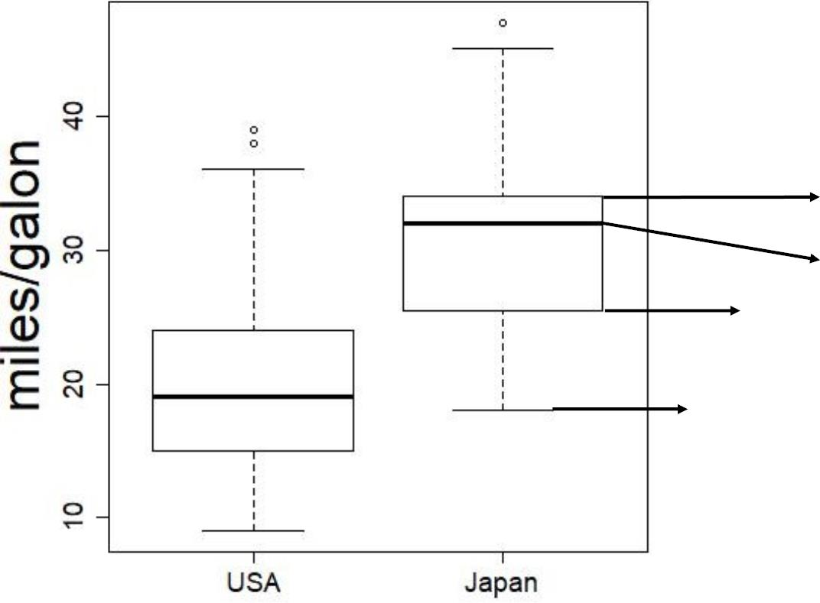
Data Example
n =249
n =79
1
2
ത =
ത
2
ത
ത
= 30.48
1
20.14
ꢀ = 6.11
2
ꢀ =
1
Serr₂ = 0.69
6.41
Serr₁ =
0.41
Q₃ (75%)
Median (50%)
Q₁ (25%)
Q -1.5*(Q – Q )
1
3
1
Statistics for Software
Engineers

Slide 5
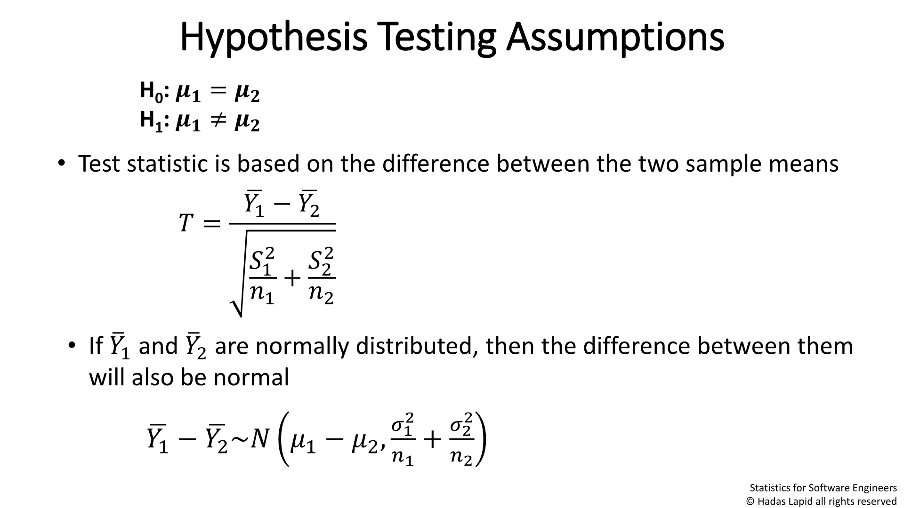
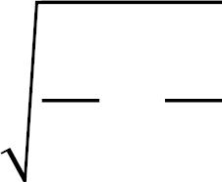
Hypothesis Testing Assumptions
H : ꢀ = ꢀ
ꢀ ꢀ
ത ത
0
1
H : ത ≠ ത
• Test statistic is based on the difference between the two sample
means
ത ത
ꢀ =
ത ത
1
2
−
ꢀ ꢀ
ꢀ ꢀ
1
+
2
ꢀ ꢀ
ꢀ ꢀ
ത ത are normally distributed, then the difference between
• If
ത
ത
1
2
and them
will also be normal
Statistics for Software
Engineers
Notes:
Mahalanobis distance

Slide 6
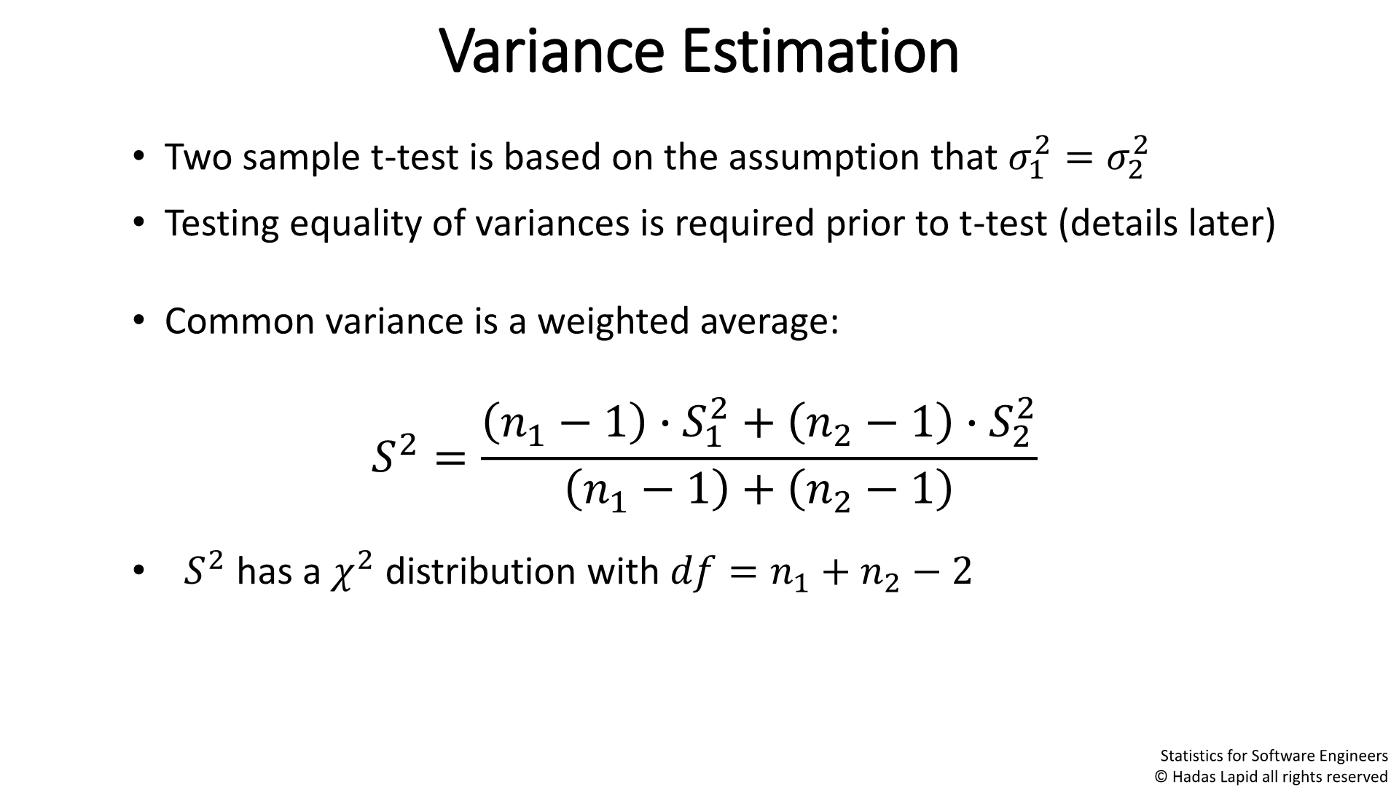




Variance Estimation
• Two sample t-test is based on the assumption that ത
= ത
2
2
1
2
• Testing equality of variances is required prior to t-test (details later)
• Common variance is a weighted
average:
ത ²
ത − 1∙ ത
∙
2
+
ത ₂ −
ത − ത −
1
ꢀ ² =
1
2
+
1
2
• ത ² has a ത ² distribution with ത ത = ത + ത − 2
1
2
Statistics for Software
Engineers

Slide 7
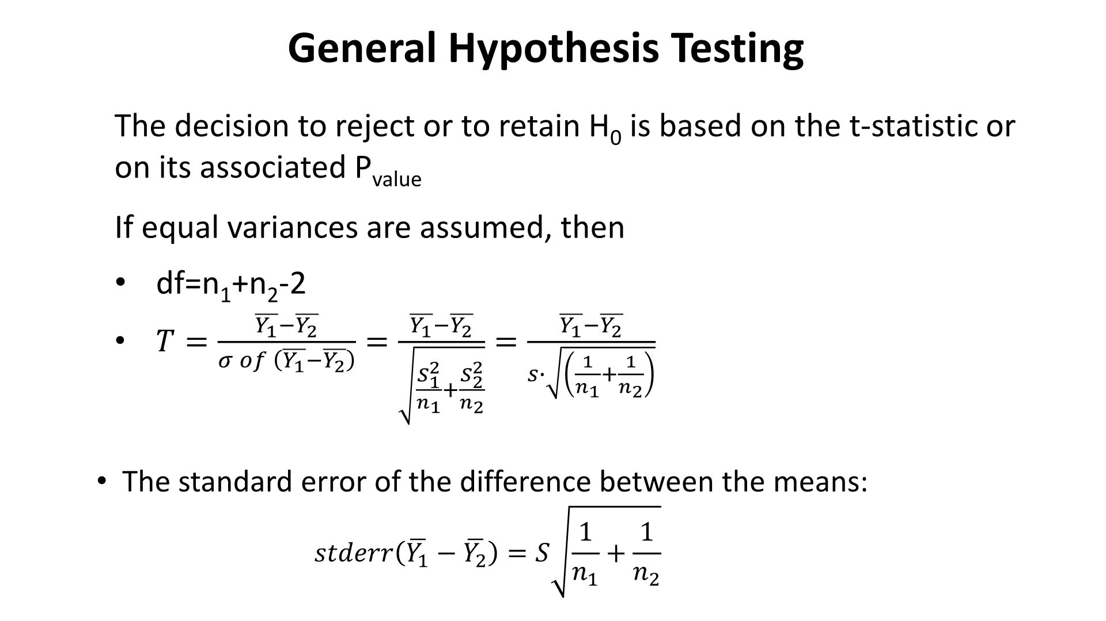
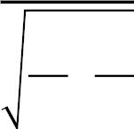
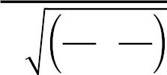

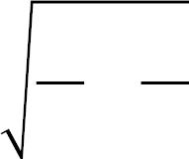

General Hypothesis Testing
The decision to reject or to retain H₀ is based on the t-statistic
or on its associated P_{value}
If equal variances are assumed, then
• df=n +n -2
1 2
=
^{ത}1^{−ത}
• ത
=
2
=
ത − ത
ത −ത
1 1
1
ꢀ ¹ ത
1 2
1
2
ത
2
+
ꢀ ꢀ
ꢀ
−
ത
ꢀ
1
+
ꢀ
2
1
• The standard error of the difference between the means:
ത −
1 1
ꢀ
1
ꢀ ꢀ ꢀ ꢀ ꢀ ꢀ = ꢀ
ത
+
1

Slide 8
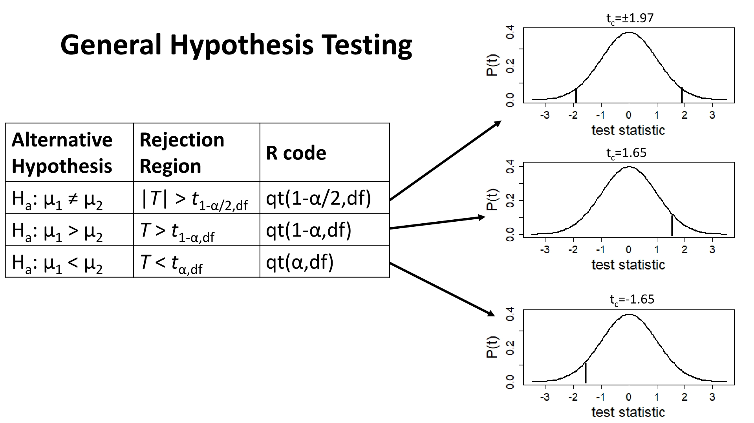
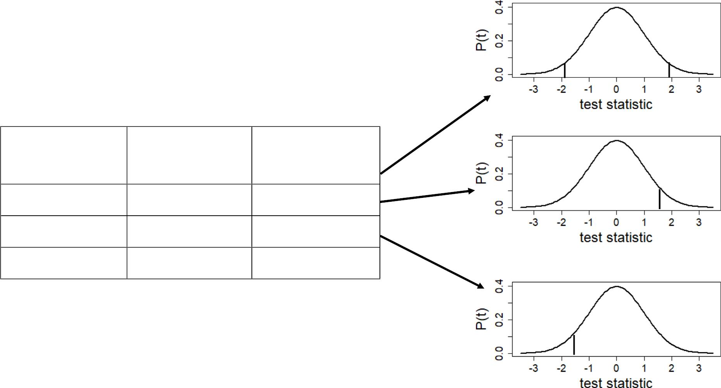
t_{c}=±1.97
General Hypothesis
Testing
Alternative Rejection
Hypothesis Region
R code
^{t}c^{=1.65}
H : μ ≠ μ
^{|T| > t}1-α/2,df
^{T > t}1-α,df
^{T < t}α,df
qt(1-α/2,df)
qt(1-α,df)
qt(α,df)
a 1
2
H : μ > μ
a 1
2
H : μ < μ
a 1
2
t_{c}=-1.65

Slide 9
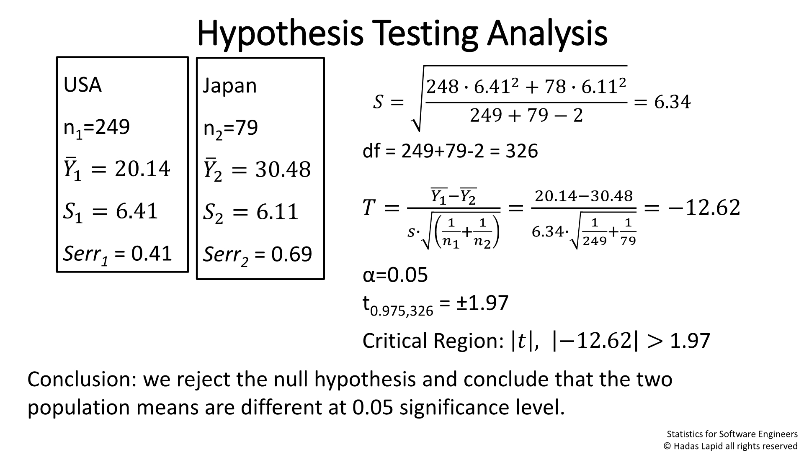


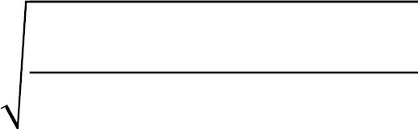

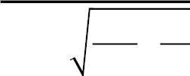
Hypothesis Testing Analysis
USA
Japa
n
248 ∙ 6.41² + 78 ∙ 6.11²
ꢀ =
= 6.34
n₁=24
249 + 79 − 2
df = 249+79-2 = 326
9
n₂=7
ത =
ത₁−ത
ത =
2
=
20.14−30.48
= −12.62
ത
9
1
ത
1 1
1 1
+
6.34∙
+
20.14 ത =
ꢀ
249 79
ത
1
ꢀ = 6.41
2
α=0.05
t_{0.975,326} = ±1.97
30.48
Critical Region: ത , −12.62 > 1.97
Conclusion: we reject the null hypothesis and conclude that the two
population means are different at 0.05 significance
level.
Statistics for Software
Engineers
© Hadas Lapid all rights

Slide 10
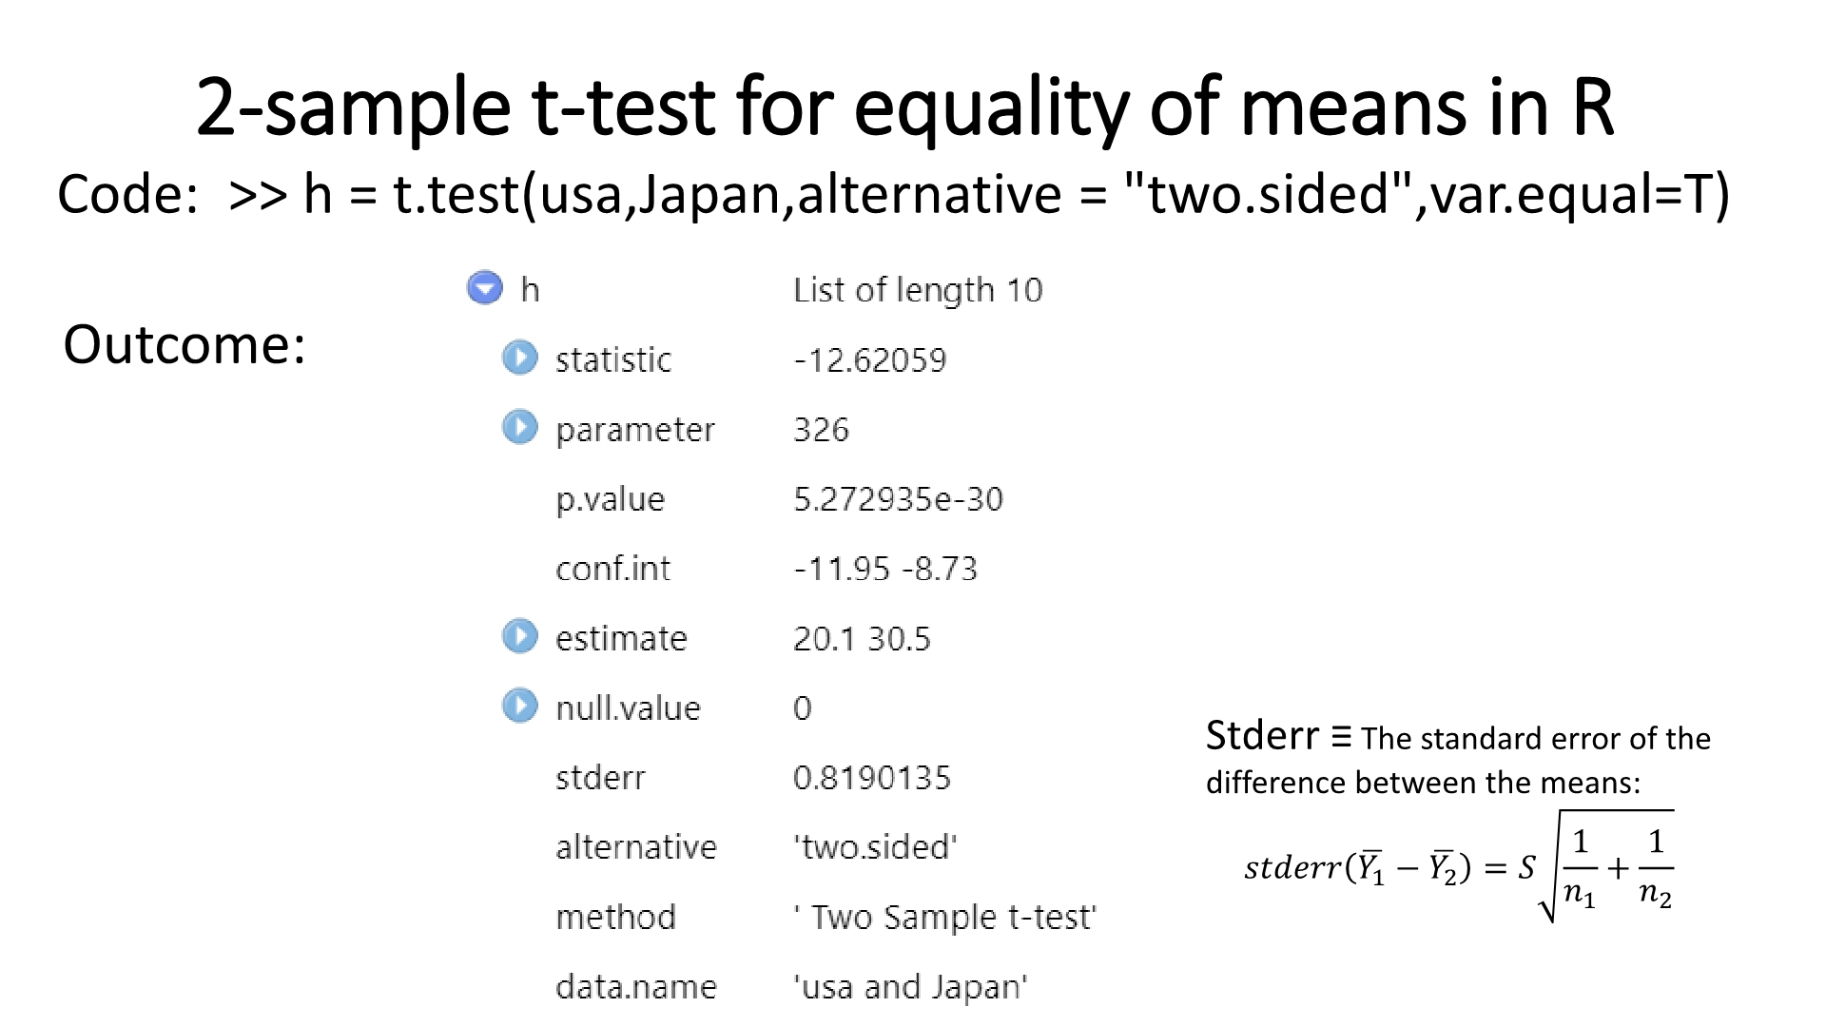
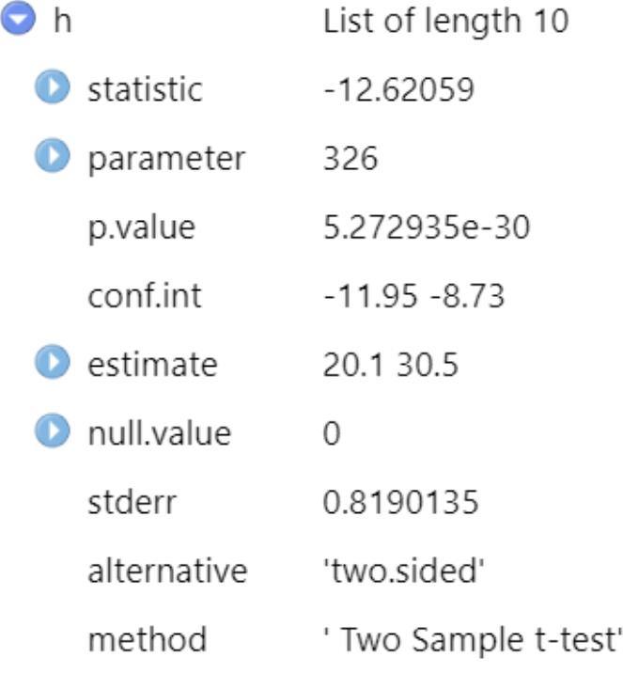
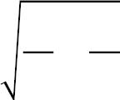

2-sample t-test for equality of means in R
Code: >> h = t.test(usa,Japan,alternative =
"two.sided",var.equal=T)
Outcome:
Stderr ≡ The standard error of the
difference between the means:
ꢀ ꢀ ꢀ ꢀ ꢀ
ത−
1
1
= ꢀ
+
ത
ꢀ
ത
ꢀ
ത
1
2
2
ത
1
Notes:
http://www.sthda.com/english/wiki/unpaired-two-samples-t-test-in-r

Slide 11
Testing Equality of Variances
Levene test
• Compares mean absolute deviations from the mean of the different
groups
• Has been shown to test equality of variances and not normality
• Extendable to more than 2 groups
F test
• Based on direct comparison of S ² and S ²
1
2 .
• Uses F distribution (later)
• Based on normality assumption of the variable in the two groups
• Can only be used for case of 2 groups
Notes:
7.4, page 382
Levene test can be obtained from R

